Slide 1
Copyright Notice
These slides are distributed under the Creative Commons License.
DeepLearning.AI makes these slides available for educational purposes. You may not use or distribute these slides for commercial purposes. You may make copies of these slides and use or distribute them for educational purposes as long as you cite DeepLearning.AI as the source of the slides.
For the rest of the details of the license, see https://creativecommons.org/licenses/by-sa/2.0/legalcode

Slide 2
Advanced Learning Algorithms
Welcome!

Slide 3



Advanced learning algorithms
Neural Networks inference (prediction) training
Practical advice for building machine learning systems Decision Trees
Andrew Ng

Slide 4
Neural Networks Intuition
Neurons and the brain

Slide 5


Neural networks
Origins: Algorithms that try to mimic the brain.
Used in the 1980’s and early 1990’s. Fell out of favor in the late 1990’s.
Resurgence from around 2005. speech images text (NLP)
Andrew Ng

Slide 6





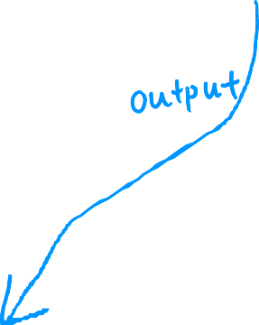




Neurons in the brain
[Credit: US National Institutes of Health, National Institute on Aging]

Slide 7

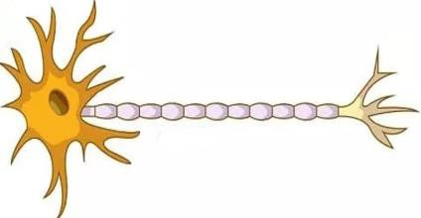







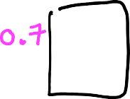










Biological neuron
Simplified mathematical model of a neuron
inputs outputs
inputs
outputs
image source: https://biologydictionary.net/sensory-neuron/

Slide 8



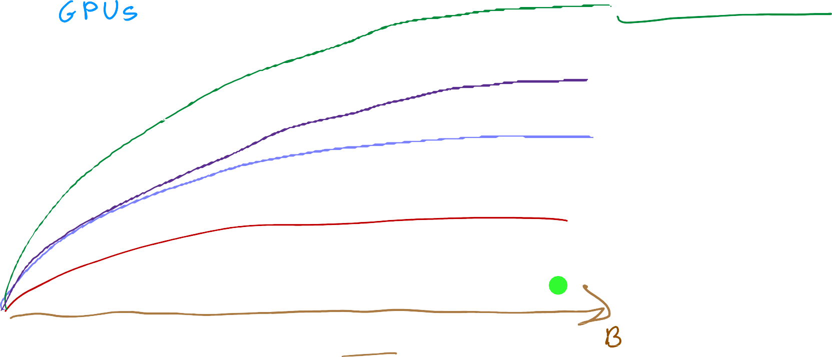


Why Now?
large neural network
medium neural network small neural network
performance
traditional AI
amount of data

Slide 9
Neural Network Intuition
Demand Prediction

Slide 10


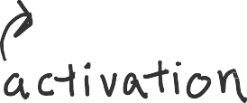
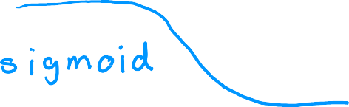



Demand Prediction
input output
𝑥 = 𝑝𝑟𝑖𝑐𝑒
1
𝑎 = 𝑓 𝑥 =
_{1 + 𝑒}− 𝑤𝑥+𝑏
top seller? yes/no
𝑥
𝑎
price

Slide 11
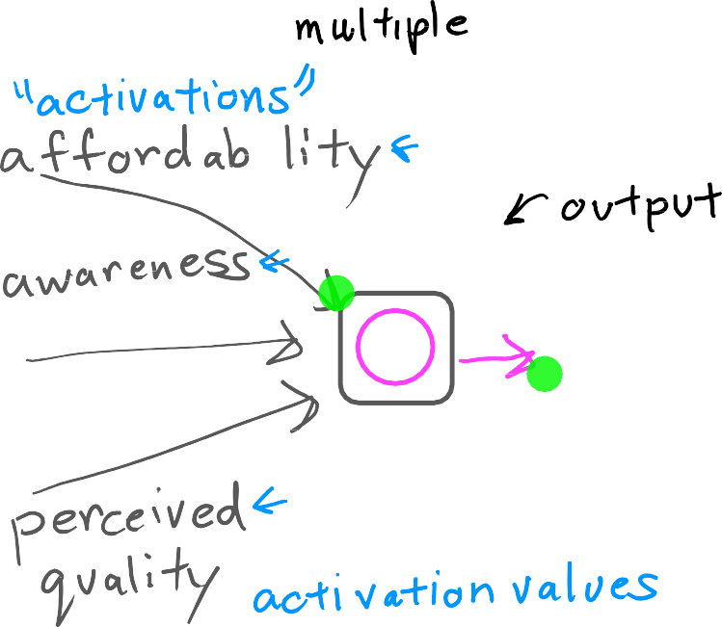




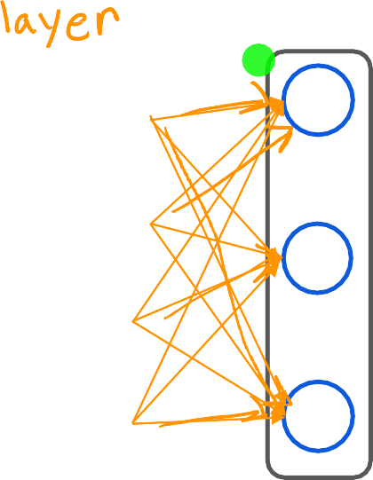





Demand Prediction
layer
price
layer
shipping cost
probability of being a top seller
marketing
material

Slide 12


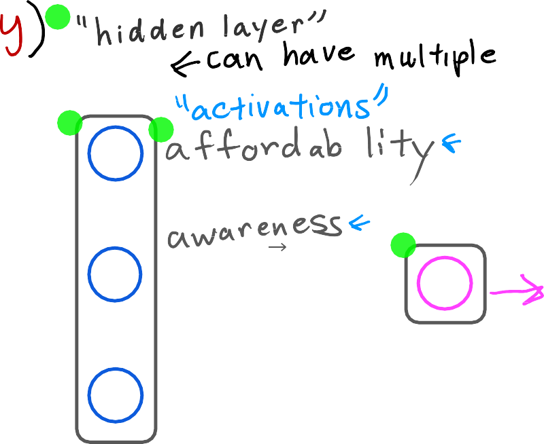



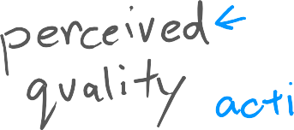


Demand Prediction
layer
price
layer
shipping cost
a
a
probability of being a top seller
marketing
material

Slide 13
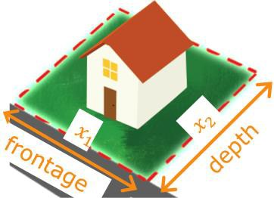


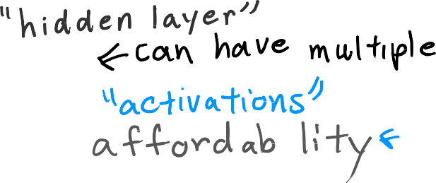






Demand Prediction
layer
price
shipping cost marketing material
layer
a
a
probability of being a top seller

Slide 14








Multiple hidden layers
x
input
a
a
x
output layer
hidden layer
hidden layer
hidden layer
hidden layer
hidden layer
neural network architecture

Slide 15




Neural Networks Intuition
Example: Recognizing Images

Slide 16





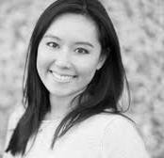





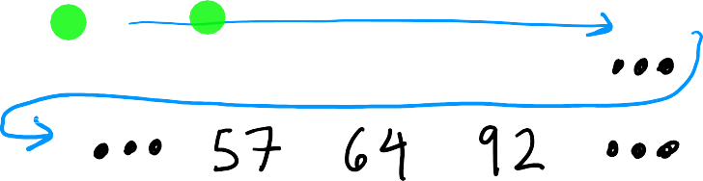










Face recognition
x =

Slide 17
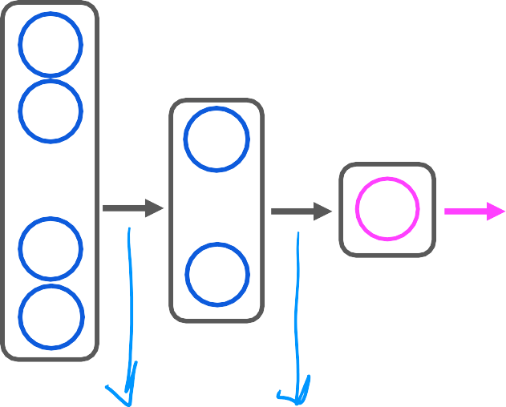








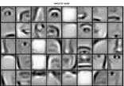


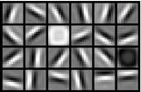
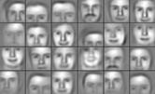




Face recognition
output layer
⋮
⋮
⋮
probability of being
person ‘XYZ’
x
input
source: Convolutional Deep Belief Networks for Scalable Unsupervised Learning of Hierarchical Representations by Honglak Lee, Roger Grosse, Ranganath Andrew Y. Ng

Slide 18

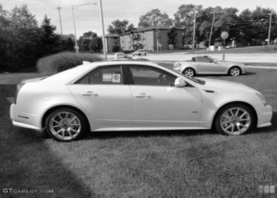
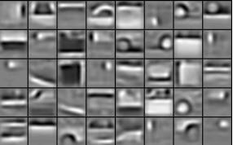
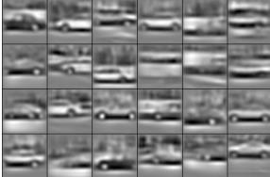




Car classification
output layer
⋮
⋮
⋮
probability of car detected
source: Convolutional Deep Belief Networks for Scalable Unsupervised Learning of Hierarchical Representations by Honglak Lee, Roger Grosse, Ranganath Andrew Y. Ng

Slide 19
Neural network model
Neural network layer

Slide 20

Neural network layer
x

Slide 21





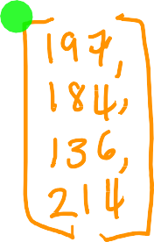





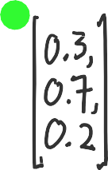






Neural network layer
1
𝑔(𝑧) =
1 + 𝑒^{− 𝑧}
a
]
x
𝑤 , 𝑏₁
𝑎
= 𝑔(w
x + 𝑏 )
vector of activation values from layer 1
layer 0
layer 2
x
w₂ , 𝑏₂
𝑎₂ = 𝑔(w₂ ∙ x + 𝑏₂ )
a
layer 1
w₃ , 𝑏₃
𝑎₃ = 𝑔(w₃ ∙ x + 𝑏₃ )
notation for layer numbering

Slide 22







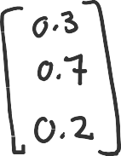

Neural network layer
1
𝑔(𝑧) =
1 + 𝑒^{− 𝑧}
_{a}[1]
_{𝑎}[2]
x
layer 2
𝑤₁ , 𝑏₁
𝑎₁ = 𝑔(w₁ ∙ a^{[1]} + 𝑏₁ )
a scalar value
_{a}[1]
a
layer 1

Slide 23
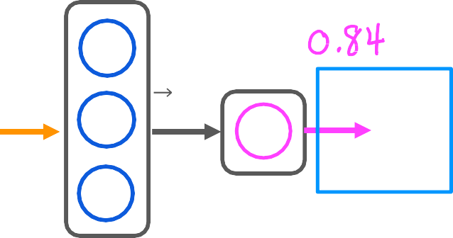
Neural network layer
predict category 1 or 0 (yes/no)
_{𝑎}[2]
_{a}[1]
x
layer 2
layer 1

Slide 24
Neural Network Model
More complex neural networks

Slide 25
More complex neural network
_{a}[1]
_{a}[2]
_{a}[3]
_{a}[4]
x
input
layer 0
layer 1
layer 2
layer 3
layer 4
hidden layers
output
layer

Slide 26
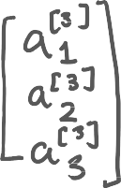

More complex neural network
𝑤
_{, 𝑏}[3
𝑎₁ = 𝑔(w₁
𝑎₂ = 𝑔(w₂
a^{[2]} + 𝑏₁ )
a^{[2]} + 𝑏₂ )
1
1
_{a}[1]
_{a}[2]
_{a}[3]
_{, 𝑏}[3
x
input
a
[4]
a
[2]
w
a
[3]
2
2
_{w}[ _{, 𝑏}[3
𝑎 = 𝑔(w
a^{[2]} + 𝑏 )
3
3
3
3
3
layer 1
layer 2
layer 3
layer 4

Slide 27

Notation
_{𝑤}[3]_{, 𝑏}[3]
𝑎^{[3]}= 𝑔(w^{[3]} ∙ a^{[2]} + 𝑏^{[3]})
1 1 1
𝑎[ ]= 𝑔(w[ ] ∙ a[ ] + 𝑏[ ])
1 1
x
input
_{a}[1]
_{a}[2]
_{a}[3]
_{w}[3]_{, 𝑏}[3]
a
[4]
a
[2]
a
[3]
2 2
_{w}[3]_{, 𝑏}[3]
𝑎^{[3]}= 𝑔(w^{[3]} ∙ a^{[2]} + 𝑏^{[3]})
3 3 3
3 3
layer 1
layer 2
layer 3
layer 4
Question:
Can you fill in the superscripts and
subscripts for the second neuron?

Slide 28


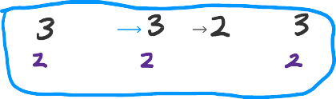




Notation
x
x
input
_{𝑤}[3]_{, 𝑏}[3]
𝑎^{[3]}= 𝑔(w^{[3]} ∙ a^{[2]} + 𝑏^{[3]})
1 1 1
𝑎[ ]= 𝑔(w[ ] ∙ a[ ] + 𝑏[ ])
1 1
_{a}[1]
_{a}[2]
_{a}[3]
_{w}[3]_{, 𝑏}[3]
a
[4]
a
[2]
a
[3]
2 2
_{w}[3]_{, 𝑏}[3]
𝑎^{[3]}= 𝑔(w^{[3]} ∙ a^{[2]} + 𝑏^{[3]})
3 3 3
3 3
layer 3
layer 4
layer 1 layer 2
Activation value of layer 𝑙, unit(neuron) 𝑗
_{𝑎}[3]
[3] [3]
[2]
₂ = 𝑔(w₂ ∙ a + 𝑏₂ )
output of layer 𝑙 − 1
(previous layer)
𝑎^{[𝑙]} = 𝑔(w^{[𝑙]} ∙ a^{[𝑙−1]} + 𝑏^{[𝑙]})
𝑗 𝑗 𝑗
sigmoid
Parameters w & b of layer 𝑙, unit 𝑗

Slide 29
Neural Network Model
Inference: making predictions (forward propagation)

Slide 30












Handwritten digit recognition
Digit images
label 0
1
_{a}[1]
_{a}[2]
x
⋮
a^{[3]} probability
of being a
⋮
handwritten ‘1’
output layer
25 units
layer 1
15 units
layer 2
1 unit
layer 3
_{a}[1]

Slide 31
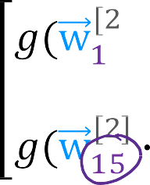




Handwritten digit recognition
Digit images
label 0
1
_{a}[1]
_{a}[2]
x
⋮
a^{[3]} probability
of being a
⋮
handwritten ‘1’
output layer
25 units
layer 1
15 units
layer 2
1 unit
layer 3
_{a}[2]

Slide 32






Handwritten digit recognition
forward propagation
_{a}[1]
_{a}[2]
_{a}[3] = 𝑓(𝑥) probability of being a
handwritten ‘1’
x
⋮
_{a}[3]
2
3
⋮
= 𝑔 w ³ ∙ a + 𝑏
1 1
𝑖𝑠 𝑎 ³
≥ 0.5?
output
layer
1
15 units
layer 2
1 unit
layer 3
25 units
layer 1

Slide 33
TensorFlow implementation
Inference in Code

Slide 34


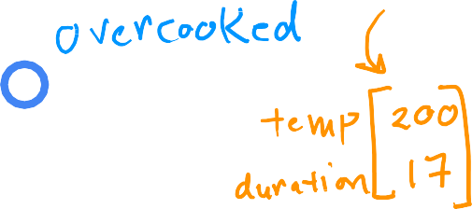








Coffee roasting
x
_{a}[1]
_{a}[2]
Duration
(minutes)
2
𝑖𝑠 𝑎₁
𝑦ො = 1
≥ 0.5?
𝑦ො = 0
Temperature
(Celsius)

Slide 35
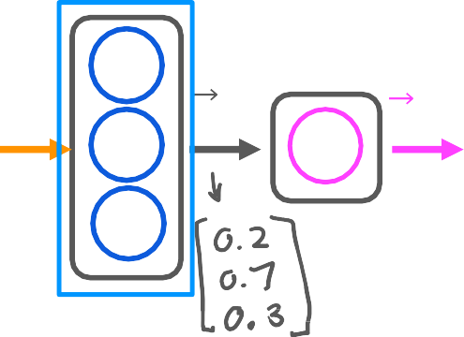


_{a}[1]
_{a}[2]
x
x = np.array([[200.0, 17.0]])
layer_1 = Dense(units=3, activation=‘sigmoid’)
a1 = layer_1(x)

Slide 36
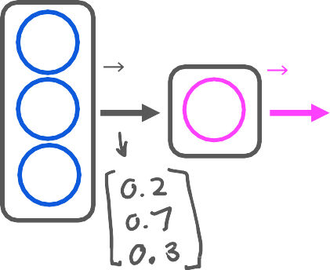

Build the model using TensorFlow
_{a}[1]
_{a}[2]
x
x = np.array([[200.0, 17.0]])
layer_1 = Dense(units=3, activation=‘sigmoid’)
a1 = layer_1(x)
layer_2 = Dense(units=1, activation=‘sigmoid’)
a2 = layer_2(a1)

Slide 37
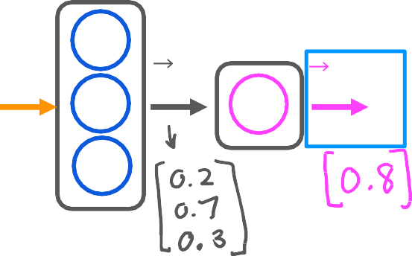



Build the model using TensorFlow
_{a}[1]
_{a}[2]
x
𝑖𝑠 𝑎 ²
≥ 0.5?
1
𝑦ො = 1
𝑦ො = 0
x = np.array([[200.0, 17.0]])
layer_1 = Dense(units=3, activation=‘sigmoid’)
a1 = layer_1(x)
if a2 >= 0.5:
yhat = 1
else:
yhat = 0
layer_2 = Dense(units=1, activation=‘sigmoid’)
a2 = layer_2(a1)

Slide 38
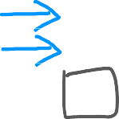

Model for digit classification
⋮
x = np.array([[0.0,...245,...240...0]])
layer_1 = Dense(units=25, activation=‘sigmoid’)
a1 = layer_1(x)
x
_{a}[1]
_{a}[2]
_{a}[3]
⋮
1 unit
15 units
25 units

Slide 39


Model for digit classification
x = np.array([[0.0,...245,...240...0]])
layer_1 = Dense(units=25, activation=‘sigmoid’)
a1 = layer_1(x)
x
_{a}[1] _{a}[2]
_{a}[3]
⋮
layer_2 = Dense(units=15, activation=‘sigmoid’)
a2 = layer_2(a1)
⋮
1 unit
15 units
25 units

Slide 40


Model for digit classification
x = np.array([[0.0,...245,...240...0]])
layer_1 = Dense(units=25, activation=‘sigmoid’)
a1 = layer_1(x)
x
_{a}[1] _{a}[2]
_{a}[3]
⋮
layer_2 = Dense(units=15, activation=‘sigmoid’)
a2 = layer_2(a1)
⋮
1 unit
layer_3 = Dense(units=1, activation=‘sigmoid’)
a3 = layer_3(a2)
15 units
25 units

Slide 41

Model for digit classification
x = np.array([[0.0,...245,...240...0]])
layer_1 = Dense(units=25, activation=‘sigmoid’)
a1 = layer_1(x)
x
_{a}[1] _{a}[2]
_{a}[3]
⋮
layer_2 = Dense(units=15, activation=‘sigmoid’)
a2 = layer_2(a1)
⋮
1 unit
layer_3 = Dense(units=1, activation=‘sigmoid’)
a3 = layer_3(a2)
15 units
25 units
if a3 >= 0.5:
yhat = 1 else:
yhat = 0
𝑖𝑠 𝑎 ³ ≥ 0.5?
1
𝑦ො = 1 𝑦ො = 0

Slide 42
TensorFlow implementation
Data in TensorFlow

Slide 43





Feature vectors
temperature | duration | Good coffee?
(Celsius) | (minutes) | (1/0)
200.0 | 17.0 | 1
425.0 | 18.5 | 0
… | … | …
x = np.array([[200.0, 17.0]])
[[200.0, 17.0]]

Slide 44
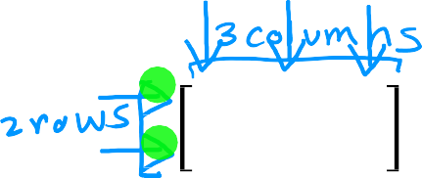




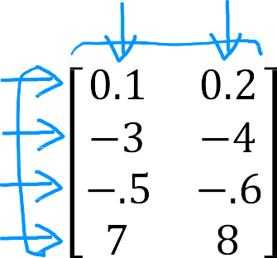



Note about numpy arrays
1 | 2 | 3
4 | 5 | 6
x = np.array([[1, | 2, | 3],
[4, | 5, | 6]])
[[1, 2, 3],
[4, 5, 6]]
2 x 3
4 x 2
1 x 2
2 x 1
x = np.array([[0.1, 0.2],
[-3.0, -4.0,],
[-0.5, -0.6,],
[7.0, 8.0,]])
[[0.1, 0.2],
[-3.0, -4.0,],
[-0.5, -0.6,],
[7.0, 8.0,]]

Slide 45

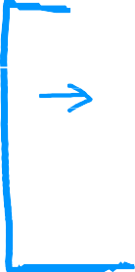


Note about numpy arrays
x = np.array([[200, 17]])
200 17
1 x 2
200
17
x = np.array([[200],
[17]])
2 x 1
x = np.array([200,17])

Slide 46

Feature vectors
temperature | duration | Good coffee?
(Celsius) | (minutes) | (1/0)
200.0 | 17.0 | 1
425.0 | 18.5 | 0
… | … | …
x = np.array([[200.0, 17.0]])
[[200.0, 17.0]]
1 x 2
200.0 17.0

Slide 47
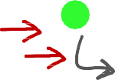



Activation vector
x
_{a}[1]
_{a}[2]
x = np.array([[200.0, 17.0]])
layer_1 = Dense(units=3, activation=‘sigmoid’)
a1 = layer_1(x)
1 x 3 matrix
tf.Tensor([[0.2 0.7 0.3]], shape=(1, 3), dtype=float32)
a1.numpy()
array([[1.4661001, 1.125196 , 3.2159438]], dtype=float32)

Slide 48


Activation vector
_{a}[1] _{a}[2]
x
layer_2 = Dense(units=1, activation=‘sigmoid’)
a2 = layer_2(a1)
1 x 1
tf.Tensor([[0.8]], shape=(1, 1), dtype=float32)
a2.numpy()
array([[0.8]], dtype=float32)

Slide 49
TensorFlow implementation
Building a neural network

Slide 50
What you saw earlier
_{a}[1]
x = np.array([[200.0, 17.0]])
x
_{a}[2]
layer_1 = Dense(units=3, activation="sigmoid") a1 = layer_1(x)
layer_2 = Dense(units=1, activation="sigmoid") a2 = layer_2(a1)

Slide 51








Building a neural network architecture
x
_{a}[1]
_{a}[2]
layer_1 = Dense(units=3, activation="sigmoid") layer_2 = Dense(units=1, activation="sigmoid")
model = Sequential([layer_1, layer_2])
x = np.array([[200.0, | 17.0],
[120.0, | 5.0],
[425.0, | 20.0],
[212.0, | 18.0])
 | y
200 17 | 1
120 5 | 0
425 20 | 0
212 18 | 1
4 x 2
y = np.array([1,0,0,1])
model.compile(...) model.fit(x,y)
model.predict(x_new)

Slide 52
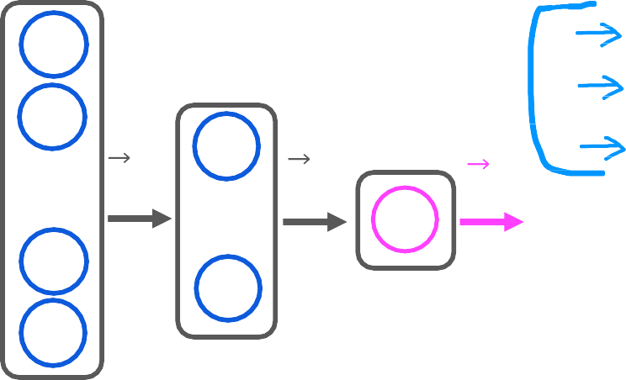






Digit classification model
layer_1 layer_2
= Dense(units=25, activation="sigmoid")
= Dense(units=15, activation="sigmoid")
= Dense(units=1, activation="sigmoid")
_{a}[1]
_{a}[2]
_{a}[3]
layer_3
x
⋮
model = Sequential([layer_1, layer_2, layer_3] model.compile(...)
⋮
1 unit
x = np.array([[0..., 245, ..., 17],
[0..., 200, ..., 184])
y = np.array([1,0])
15 units
25 units
model.fit(x,y)
model.predict(x_new)

Slide 53
Digit classification model
model = Sequential([
Dense(units=25, activation="sigmoid"), Dense(units=15, activation="sigmoid"),
Dense(units=1, activation="sigmoid")])
x
_{a}[1]
_{a}[2]
_{a}[3]
⋮
⋮
model.compile(...)
1 unit
x = np.array([[0..., 245, ..., 17],
[0..., 200, ..., 184])
y = np.array([1,0])
15 units
25 units
model.fit(x,y)
model.predict(x_new)

Slide 54
Neural network implementation in Python
Forward prop in a single layer

Slide 55
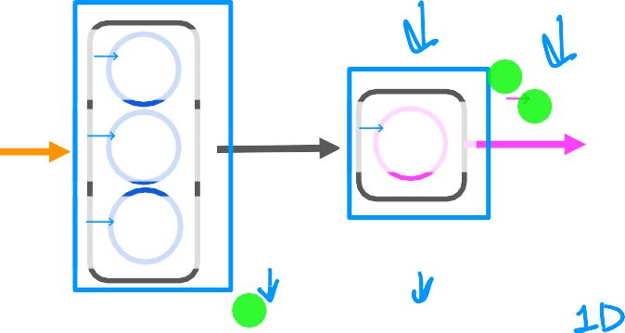








forward prop (coffee roasting model)
_{𝑎}[2]
_{𝑤}[1]_{, 𝑏}[1]
[2] [2]
₁ = 𝑔(w₁ ∙ a^{[1]} + 𝑏₁ )
w2_1 = np.array([-7, 8]) b2_1 = np.array([3]) z2_1
a2_1
1 1
_{a}[1] _{a}[2]
x
_{w}[1]_{, 𝑏}[1]
2 2
[2] [2]
𝑤₁ , 𝑏₁
_{w}[1]_{, 𝑏}[1]
= np.dot(w2_1,a1)+b2_1
= sigmoid(z1_1)
w2_1
3 3
x = np.array([200, 17])
𝑎^{[1]}= 𝑔(w^{[1]} ∙ x + 𝑏^{[1]})
1 1 1
𝑎^{[1]}= 𝑔(w^{[1]} ∙ x + 𝑏^{[1]})
2 2 2
𝑎^{[1]}= 𝑔(w^{[1]} ∙ x + 𝑏^{[1]})
3 3 3
w1_1 b1_1 z1_1 a1_1
= np.array([1, 2])
= np.array([-1])
= np.dot(w1_1,x)+ b
= sigmoid(z1_1)
w1_2 b1_2 z1_2 a1_2
= np.array([-3, 4])
= np.array([1])
= np.dot(w1_2,x)+b
= sigmoid(z1_2)
w1_3 b1_3 z1_3 a1_3
= np.array([5, -6])
= np.array([2])
= np.dot(w1_3,x)+b
= sigmoid(z1_3)
a1 = np.array([a1_1, a1_2, a1_3])
Andrew Ng

Slide 56
Neural network implemenation in Python
General implementation of forward propagation

Slide 57



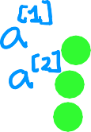









Forward prop in NumPy
_{a}[𝑙]
_{𝑤}[1]_{, 𝑏}[1]
1 1
x
_{w}[1]_{, 𝑏}[1]
2 2
def dense(a_in,W,b, g):
def sequential(x):
_{w}[1]_{, 𝑏}[1]
a1 = dense(x,W1,b1,g) a2 = dense(a1,W2,b2,g) a3 = dense(a2,W3,b3,g) a4 = dense(a3,W4,b4,g)
3 3
units = W.shape[1] a_out = np.zeros(units)
_{𝑤}[1] ₌
1 _{w}[1] ₌ −3
2 4
_{w}[1] ₌ 5
−6
for j in range(units): w = W[:,j]
z = np.dot(w,a_in) + b[j]
a_out[j] = g(z) return a_out
1
2
3
W = np.array([
f_x = a4 return f_x
[
[
1, |  | -3, | 5]
2, |  | 4, | -6]]
)
𝑏^{[𝑙]} = −1
_{𝑏}[𝑙] _{= 1 𝑏}[𝑙] ₌ ₂
1 2 3
b = np.array([-1, 1, 2])
_{a}[0] _{= x}
a_in = np.array([-2, 4])
Andrew Ng

Slide 58
Speculations on artificial general intelligence (AGI)
Is there a path to AGI?

Slide 59
AI
ANI
(artificial narrow intelligence)
E.g., smart speaker, self-driving car, web search, AI in farming and factories
AGI
(artificial general intelligence)
Do anything a human can do

Slide 60

Biological neuron
Simplified mathematical model of a neuron
inputs outputs
inputs
outputs
image source: https://biologydictionary.net/sensory-neuron/

Slide 61
Neural network and the brain
Can we mimic the human brain?
vs
x
𝑓(x)
We have (almost) no idea how the brain works

Slide 62



The ”one learning algorithm” hypothesis
Auditory cortex
Auditory cortex learns to see
[Roe et al., 1992]

Slide 63

The ”one learning algorithm” hypothesis
Somatosensory cortex
Somatosensory cortex learns to see
[Metin & Frost, 1989]

Slide 64
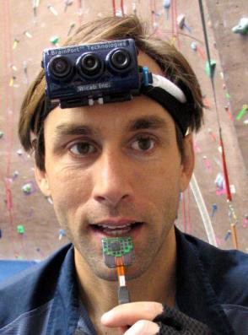
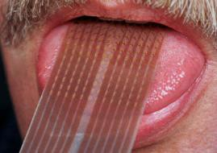
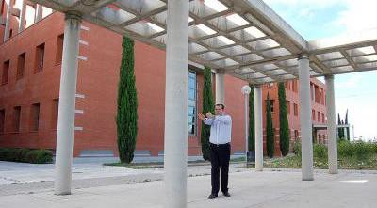
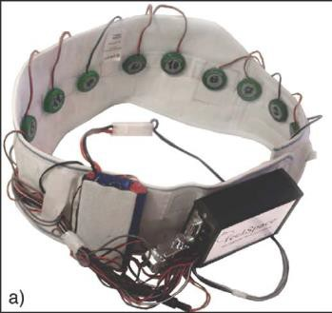

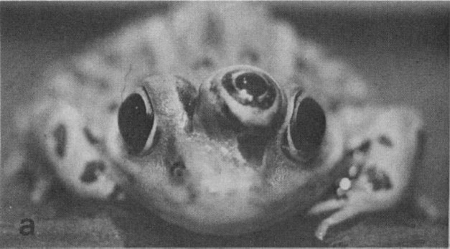
Sensor representations in the brain
Seeing with your tongue
Human echolocation (sonar)
Haptic belt: Direction sense Implanting a 3rd eye
[BrainPort; Welsh & Blasch, 1997; Nagel et al., 2005; Constantine-Paton & Law, 2009]

Slide 65
Vectorization (optional)
How neural networks are implemented efficiently

Slide 66





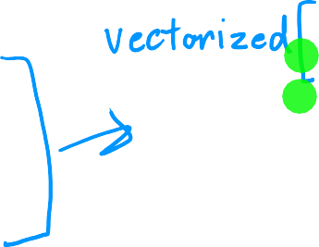



For loops vs. vectorization
x = np.array([200, 17])
W = np.array([[1, -3, 5],
[-2, 4, -6]])
b = np.array([-1, 1, 2])
def dense(a_in,W,b): a_out = np.zeros(units) for j in range(units):
w = W[:,j]
z = np.dot(w,x) + b[j] a[j] = g(z)
return a
[1,0,1]
X = np.array([[200, 17]])
W = np.array([[1, -3, 5],
[-2, 4, -6])
B = np.array([[-1, 1, 2]])
def dense(A_in,W,B):
Z = np.matmul(A_in,W) + B A_out = g(Z)
return A_out
[[1,0,1]]
Andrew Ng

Slide 67
Vectorization (optional)
Matrix multiplication

Slide 68




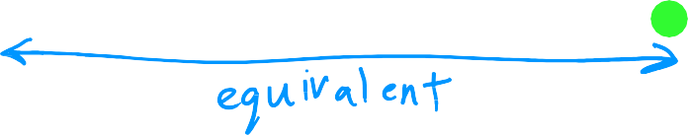

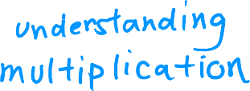




Dot products
example
in general
transpose
vector vector multiplication
1 3
2 4
↑ ↑
a ∙ w
↓ ↓
1
2
_{a}𝑻
↑ w
↓
∙
a =
← →
a^{𝑻} = 1 2
𝑧 = a ∙ w
𝑧 = a^{𝑻}w
Andrew Ng

Slide 69


Vector matrix multiplication
→a =
1
[2]
→
W =
3 5
→
→
a = [1 2]
[4 6]
Z = a W
[ ←
a
→ ]
→_{w} →_{w}
1
2
Z = (1 ∗ 3) + (2 ∗ 4)
→ → →
[ a w ₁ a w
2
]
₍1 ∗ 5₎ + (2 ∗ 6)
Z = [11
17]

Slide 70
matrix matrix multiplication
A =
1 −1
[2
−2]
_{→a} T
1 2
W = _{[4}
3 5
Z = A
6
W =
←
→
A =
]
1
→_{w} →_{w}
[−1 −2]
_{→a} T
1
2
←
2
→
→^{T} → →^{T} →
a ₁ w ₁
a ₁ w ₂
=
→^{T} → →^{T} →
a ₂ w ₁
a ₂ w ₂
=
11 17
[−11 −17]

Slide 71
Vectorization (optional)
Matrix multiplication rules

Slide 72
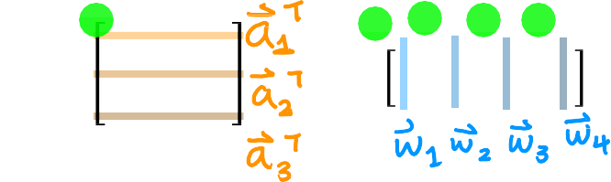
Matrix multiplication rules
1 −1 0.1
2 −2 0.2
1 2
𝐀 = −1 −2
0.1 0.2
𝐀 =
𝑻
𝐖 =
3 5 7 9
4 6 8 0
𝒁 = 𝐀^{𝑻}𝐖 =

Slide 73















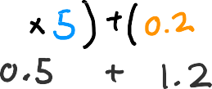












Matrix multiplication rules
1 −1 0.1
2 −2 0.2
1 2
𝐀 =
𝑻
3 5 7 9
4 6 8 0
𝐀 =
−1 −2
𝐖 =
𝒁 = 𝐀^{𝑻}𝐖 =
0.1 0.2

Slide 74
Matrix multiplication rules
1 −1 0.1
2 −2 0.2
1 2
11 17 23 9
−11 −17 −23 −9
1.1 1.7 2.3 0.9
𝐀 =
𝑻
3 5 7 9
4 6 8 0
𝐀 =
−1 −2
𝐖 =
𝒁 = 𝐀^{𝑻}𝐖 =
0.1 0.2

Slide 75



















Matrix multiplication rules
1 −1 0.1
2 −2 0.2
1 2
11 17 23 9
−11 −17 −23 −9
1.1 1.7 2.3 0.9
𝐀 =
𝑻
3 5 7 9
4 6 8 0
𝐀 =
−1 −2
𝐖 =
𝒁 = 𝐀^{𝑻}𝐖 =
0.1 0.2

Slide 76
Vectorization (optional)
Matrix multiplication code

Slide 77



Matrix multiplication in NumPy
1 −1 0.1
2 −2 0.2
1 2
11 17 23 9
−11 −17 −23 −9
1.1 1.7 2.3 0.9
𝐀 =
𝑻
3 5 7 9
4 6 8 0
𝐀 =
−1 −2
𝐖 =
𝒁 = 𝐀^{𝑻}𝐖 =
0.1 0.2
A=np.array([1,-1,0.1],
[2,-2,0.2]])
W=np.array([3,5,7,9],
[4,6,8,0])
Z = np.matmul(AT,W) Z = AT @ W
AT=np.array([1,2],
[-1,-2],
[0.1,0.2])
[[11,17,23,9],
[-11,-17,-23,-9],
[1.1,1.7,2.3,0.9]
]
AT=A.T

Slide 78




Dense layer vectorized
_{𝑤}[1]_{, 𝑏}[1]
1 1
_{𝐀}[1] _{𝐀}[2]
AT = np.array([[200, 17]])
𝐀
𝑻
_{w}[1]_{, 𝑏}[1]
W = np.array([[1, -3, 5],
[-2, 4, -6])
b = np.array([[-1, 1, 2]])
2 2
_{w}[1]_{, 𝑏}[1]
3 3
def dense(AT,W,b,g):
z = np.matmul(AT,W) + b a_out = g(z)
return a_out
𝐀^{𝑻} =
200 17
𝐙 = 𝐀^{𝑻}𝐖 + 𝐁
165
−531 |  | 900
𝐖 =
1
−2
−3
4
5
−6
_{𝑧}[1] _{𝑧}[1]
1 2
𝐀 = g(𝐙)
1 0 1
_{𝑧}[1]
[[1,0,1]]
3
^{Ԧ}𝐛 =
−1 1 2

